Slide 1
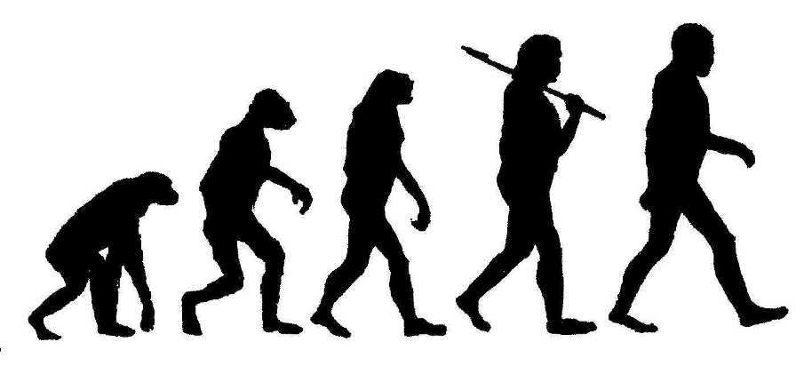
Evolutionary Feature Selection
Pattern Recognition II
Thomas Bergmüller, Lefteris Christopoulous and Martin Schnöll
4th November 2014

Slide 2
Evolutionary Algorithms for Feature Selection Introduction
Evolutionary Algorithms (EA), used for feature selection, belong to the parallel feature selection techniques (a complete feature subset is generated at once)
They are often used for nonlinear, high-dimensional problems of exponential complexity

Slide 3
Evolutionary Algorithms for Feature Selection Basic procedure
Initialize Population of size N
Select 2 parents for mating (based on some fitness)
Mating (Generation of 2 new children)
Repeat steps 2 & 3 till initial population size N is reached -> this forms a new generation

Slide 4
Evolutionary Algorithms for Feature Selection Initialization
How are the initial chromosomes (feature subsets) generated?
By Permutation Encoding
Example (for 5 features and a given subset size of 2):
3 5 1 4 2 -> 3 5 1 4 2 -> 0 0 1 0 1
1 2 4 3 5 -> 1 2 4 3 5 -> 1 1 0 0 0

Slide 5
Evolutionary Algorithms for Feature Selection Selection of parents & mating
The parents for mating are selected based on a fitness function (in our case the accuracy of the kNN-classifier)
How are the children generated? How do they look like?
Crossover (partially matched crossover, pc = 0.6):
3|5 1|4 2 -> 3|2 4|4 2 -> 3|2 4|1 5
1|2 4|3 5 -> 1|5 1|3 5 -> 4|5 1|3 2
Mutation (pm = 0.01):
3 2 4 1 5 -> 3 1 4 2 5
4 5 1 3 2 -> 4 3 1 5 2
If no crossover or mutation happens, the children are exact copies of the parents

Slide 6
Evolutionary Algorithms for Feature Selection Parameters & Implementation
Summary of arbitrary parameters (with default values):
Population Size = 50
Generations = 100
Crossover Probability pc = 0.6
Mutation Probability pm = 0.01
Other parameters to consider
K for kNN classifier
How many runs? (Due to random initialization, more runs and averaging should probably be implemented)

Slide 7
Evolutionary Algorithms for Feature Selection Project Software and Milestones
For the implementation we will use the JEvolution package (Java), which was developed at University of Salzburg
Milestones
Testing of JEvolution package (End of November)
Actual implementation & computation (December)
Evaluation, presentation & documentation (January)

